Slide 1
Nearest Neighbor Search
M1 Keisuke Fukuta

Slide 2
Nearest Neighbor Search
Find the nearest samples in dataset

Slide 3
Nearest Neighbor Search
Application
Similar Image retrieval
Feature matching

Slide 4
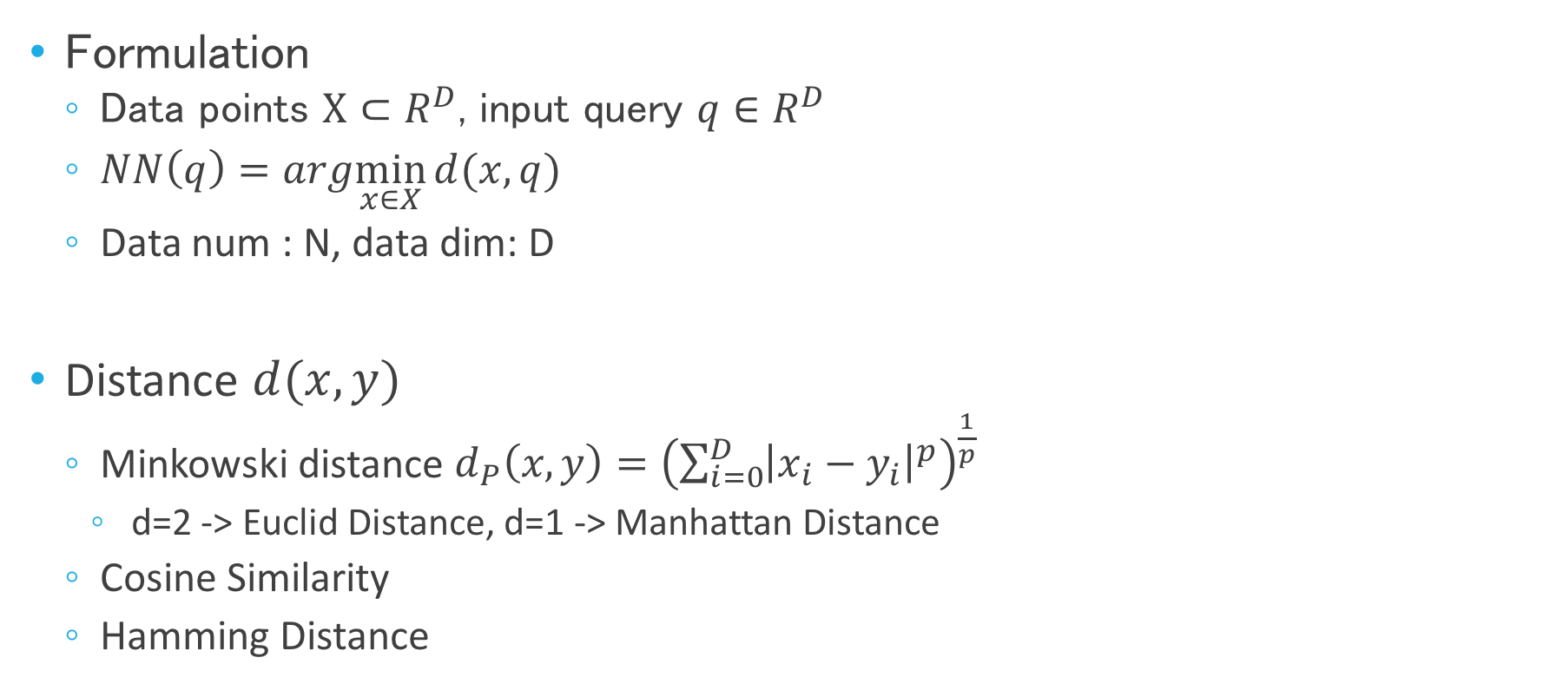
Nearest Neighbor Search
Formulation
Data points $X⊂R^{D}$, input query $q∈R^{D}$
$NN\left(q\right)=arg\min_{x∈X}{d(x, q)}$
Data num : N, data dim: D
Distance $d(x,y)$
Minkowski distance $d_{P}\left(x,y\right)={\left(\sum_{i=0}^{D}{{\left|x_{i}−y_{i}\right|}^{p}}\right)}^{\frac{1}{p}}$
d=2 -> Euclid Distance, d=1 -> Manhattan Distance
Cosine Similarity
Hamming Distance

Slide 5
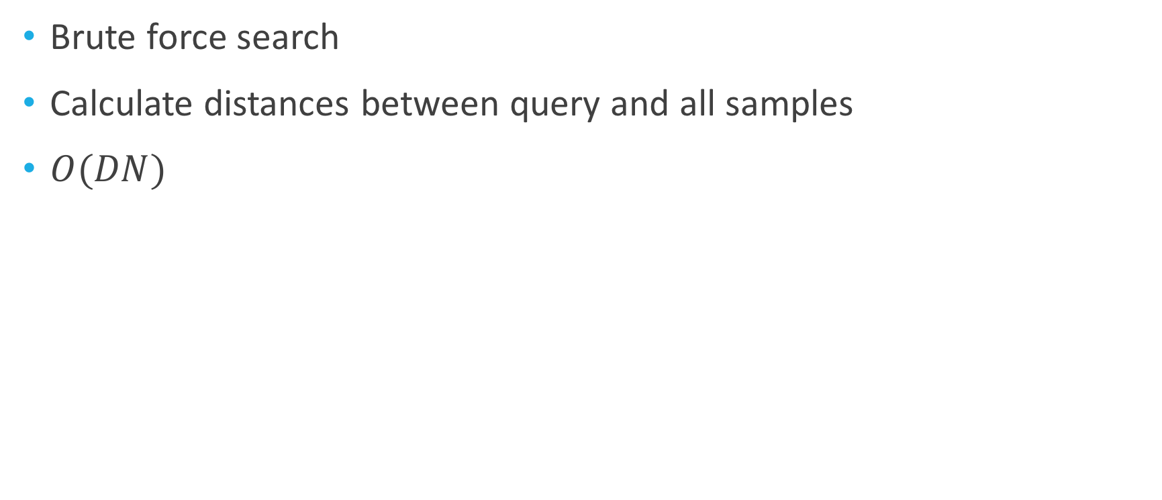
Linear Search
Brute force search
Calculate distances between query and all samples
$O(DN)$
If N >> 1, time-consuming or intractable
Curses of dimentionality

Slide 6
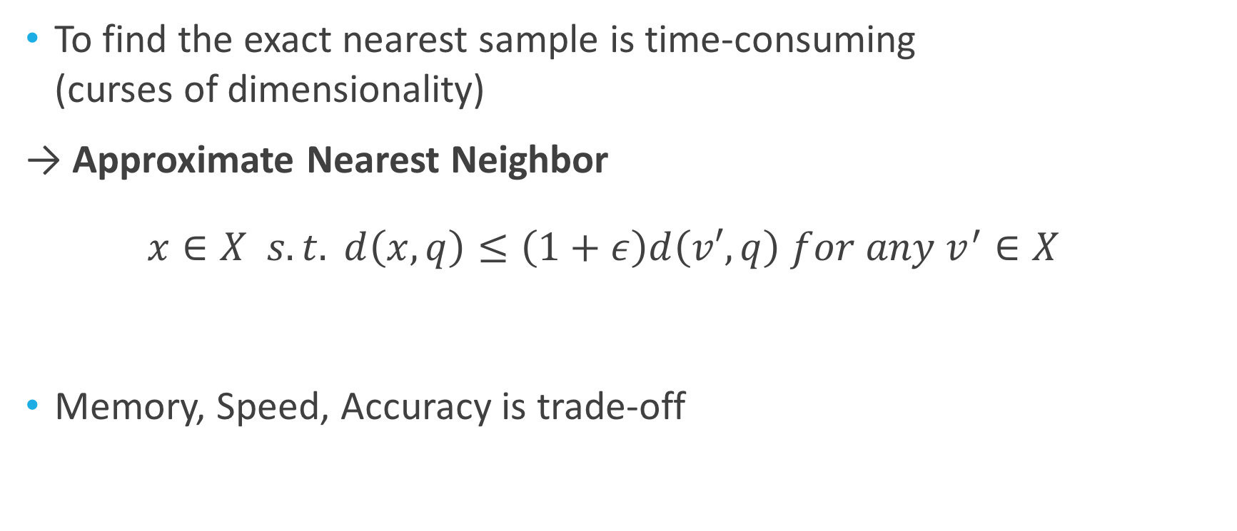
Approximate Nearest Neighbor Search
To find the exact nearest sample is time-consuming (curses of dimensionality)
→ Approximate Nearest Neighbor
$$x∈X s.t. d\left(x,q\right)≤\left(1+ε\right)d\left(v′, q\right) for any v^{′}∈X$$
Memory, Speed, Accuracy is trade-off

Slide 7
Approximate Nearest Neighbor Search
Tree-based
Hash-based
Quantization
kd-tree
Approximate kd-tree
Randomized kd-tree
Hierarchial k-means
FLANN (RKD & HKM)
Ball-tree
Vp-tree
Locality sensitive hash (LSH)
Spectral Hashing (SH)
LVQ
Product Quantization (PQ)
IDFADC
LOPQ

Slide 8
KD-tree (k-dimensional tree)
Idea
Make good data structure beforehand
→ Utilize binary tree
Guess samples (region) which is likely to be the nearest
Verification to find the exact nearest

Slide 9
Binary Tree
Left node is smaller than parent
Right node is bigger than parent

Slide 10
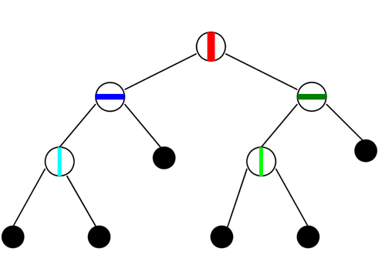
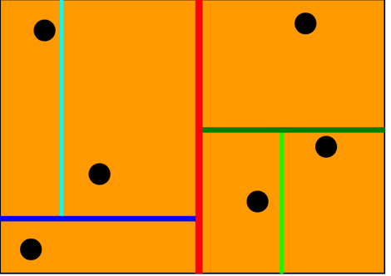
KD-tree
2-D feature space
Region
Data point
root
leaf

Slide 11
KD-tree
How to build tree ??
Choose axis whose variance is the largest
Split region with median
Repeat 1,2 in leaf nodes
( There are more smart splitting rule)
2-D feature space
Region
Data point
root

Slide 12


KD-tree
How to search?
Binary Search
Find the region that contains input query with binary search

Slide 13
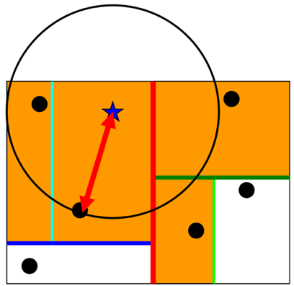
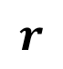
KD-tree
How to search?
Binary Search
Find the region that contains input query with binary search
Back track
Find temporal solution within the region
Find the region within r, and compare with temporal solution
Traverse every region
$$r$$

Slide 14
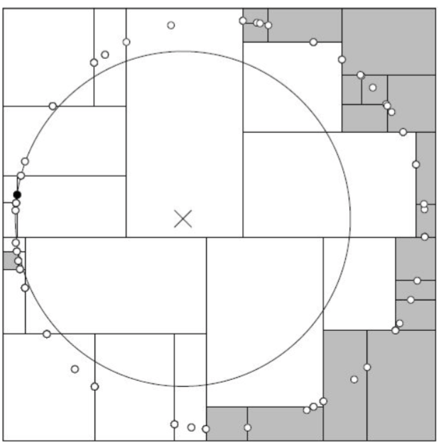
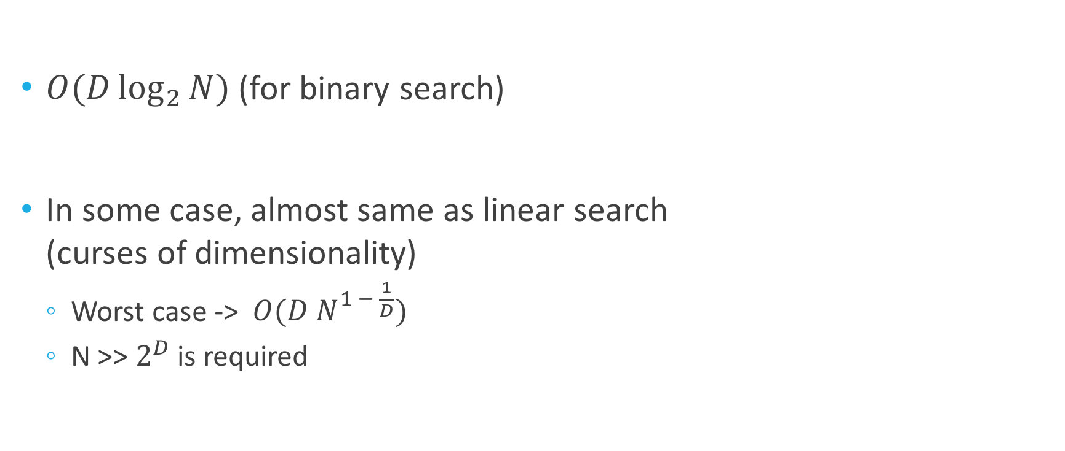
KD-tree
$O(D\log_{2}{N)}$ (for binary search)
In some case, almost same as linear search (curses of dimensionality)
Worst case -> $O(D N^{1 − \frac{1}{D}})$
N >> $2^{D}$ is required

Slide 15
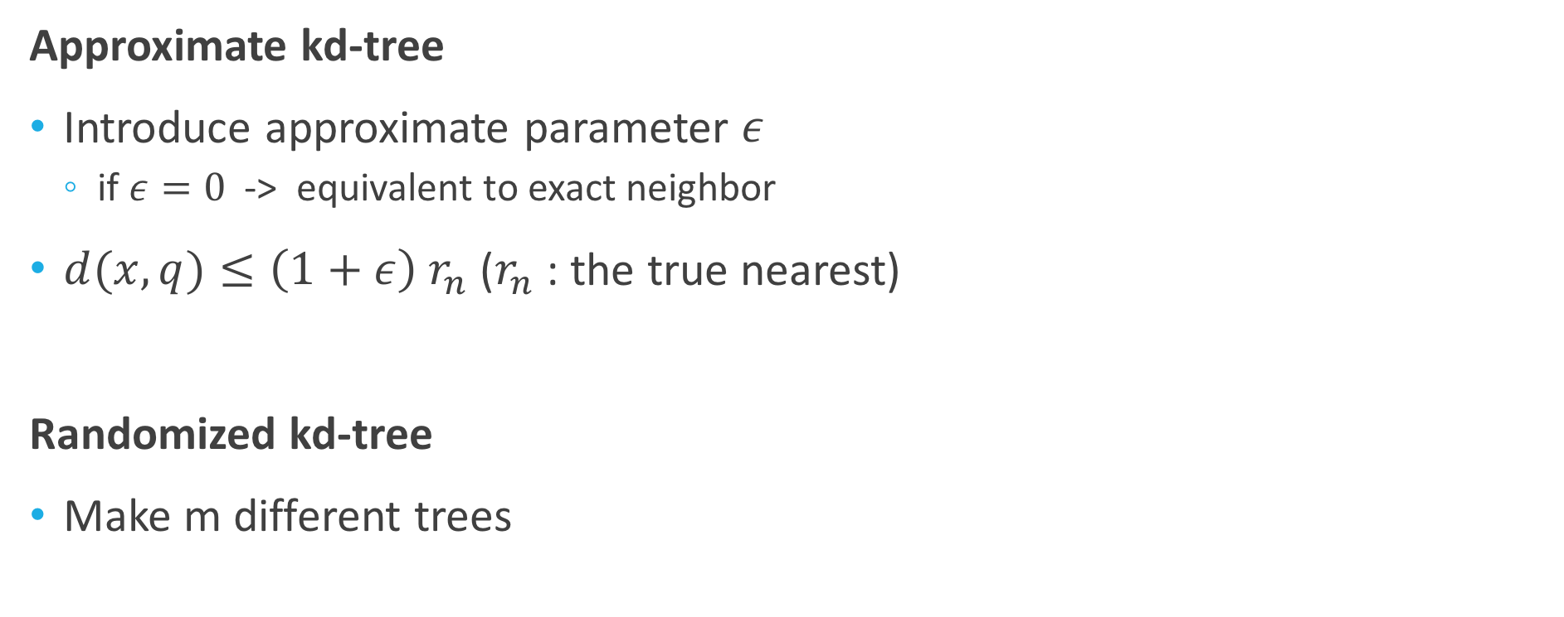
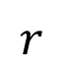
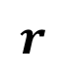
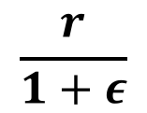
Kd-tree
Approximate kd-tree
Introduce approximate parameter $ε$
if $ε=0$ -> equivalent to exact neighbor
$d(x,q)≤\left(1+ε\right) r_{n}$ ($r_{n}$ : the true nearest)
Randomized kd-tree
Make m different trees
$$\frac{r}{1+ε}$$
$$r$$
$$r$$

Slide 16
KD-tree
Pros
Good accuracy
High speed
Cons
Very slow in high dimension

Slide 17
Approximate Nearest Neighbor Search
Tree-based
Hash-based
Quantization
kd-tree
Approximate kd-tree
Randomized kd-tree
Hierarchial k-means
FLANN (RKD & HKM)
Locality sensitive hash (LSH)
Spectral Hashing (SH)
LVQ
Product Quantization (PQ)
IDFADC
LOPQ

Slide 18
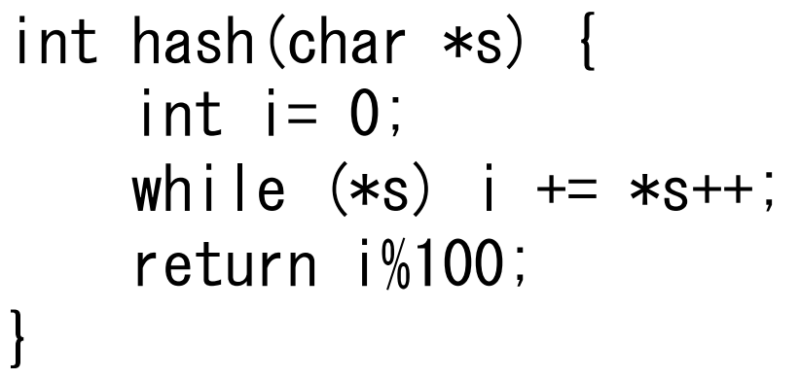
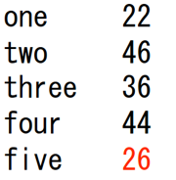
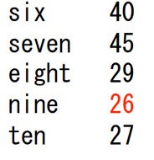
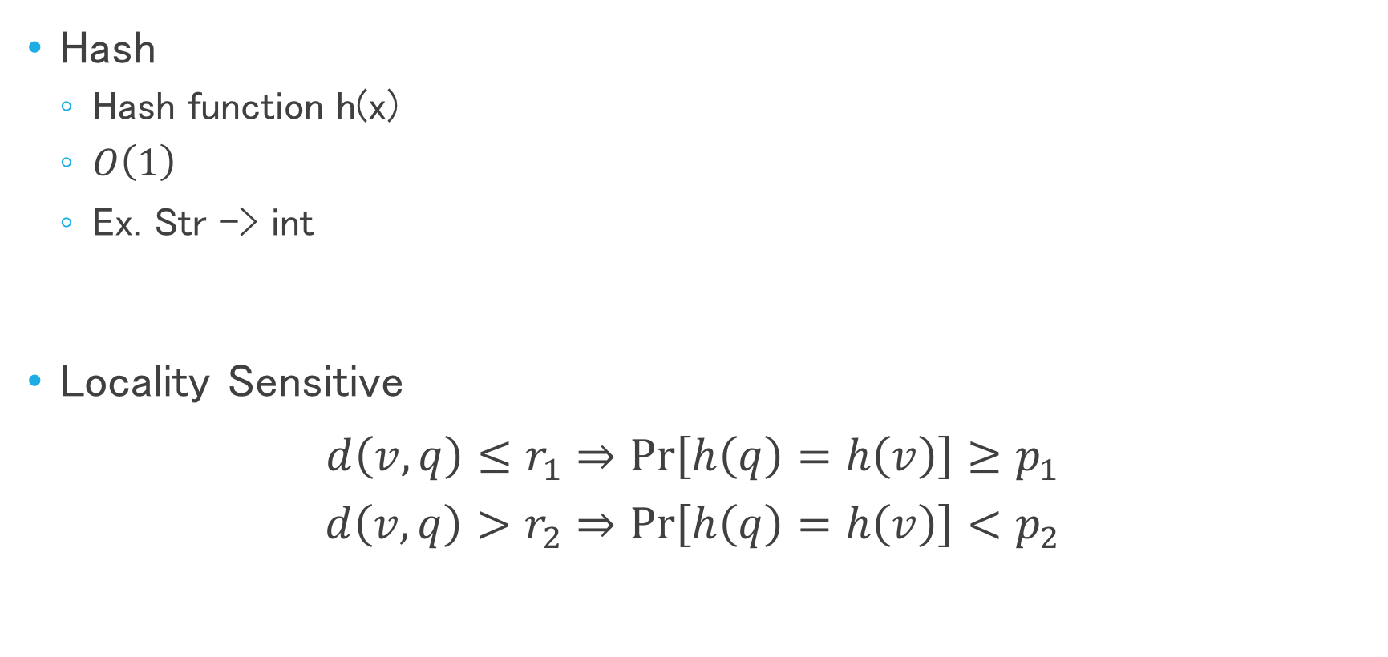
Locality Sensitive Hash
Hash
Hash function h(x)
$O\left(1\right)$
Ex. Str -> int
Locality Sensitive
$$d\left(v, q\right)≤r_{1}⇒\operatorname{Pr}\left[h\left(q\right)=h\left(v\right)\right]≥p_{1}$$
$$d\left(v, q\right)>r_{2}⇒\operatorname{Pr}\left[h\left(q\right)=h\left(v\right)\right]<p_{2}$$
Collision

Slide 19
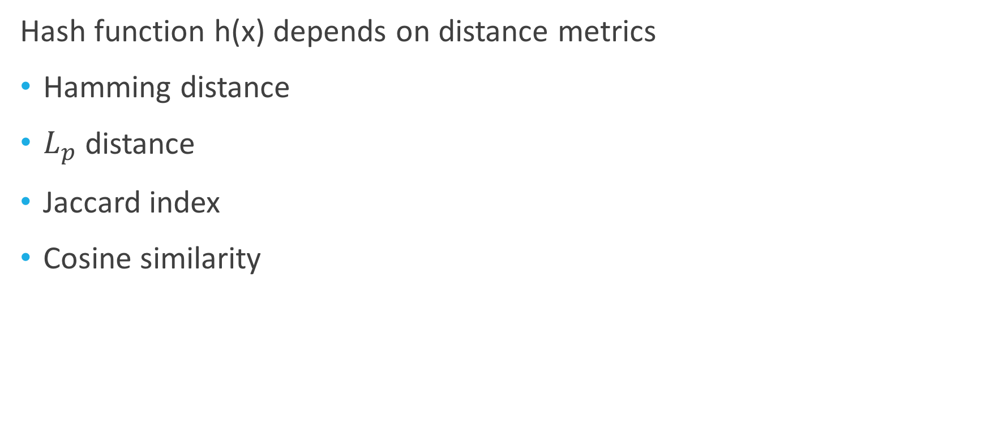
Locality Sensitive Hash
Hash function h(x) depends on distance metrics
Hamming distance
$L_{p}$ distance
Jaccard index
Cosine similarity

Slide 20
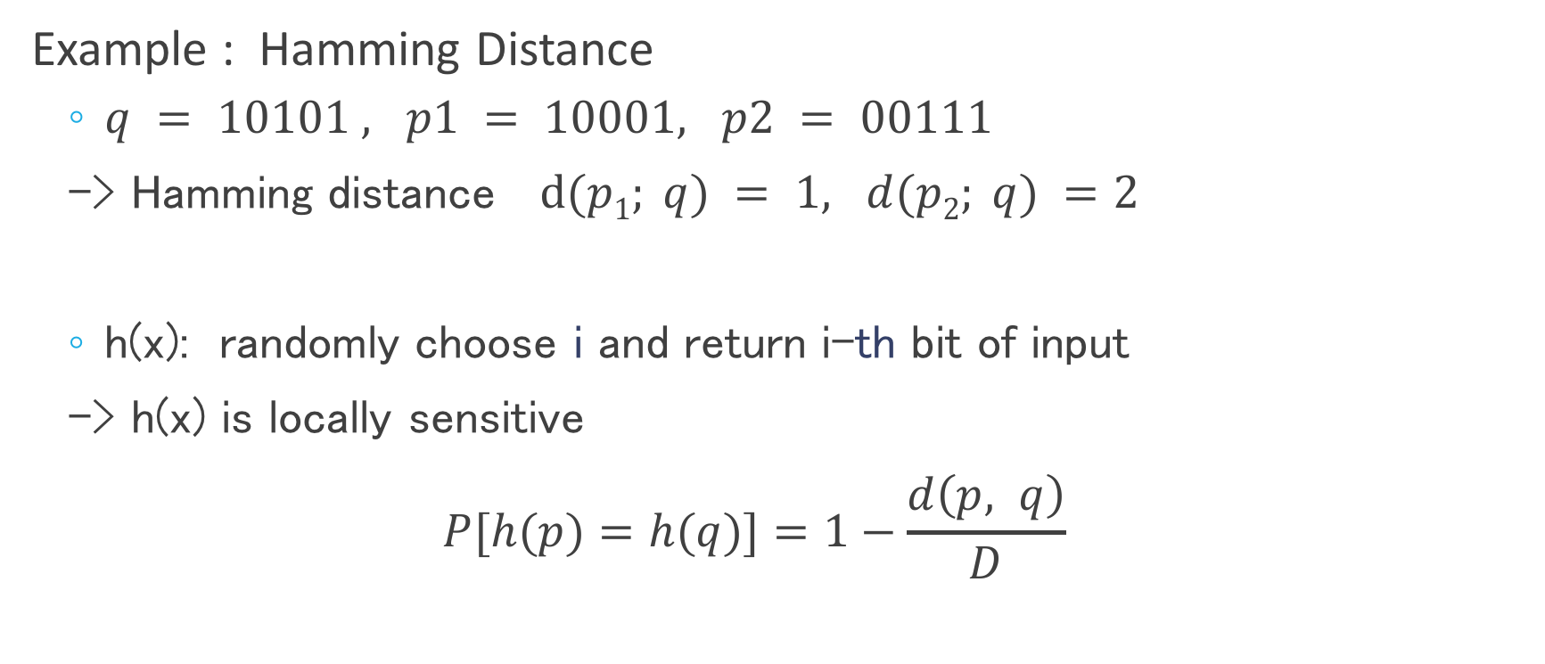
Locality Sensitive Hash
Example : Hamming Distance
$q = 10101 , p1 = 10001, p2 = 00111$
-> Hamming distance $d(p1; q) = 1, d(p2; q) =2$
h(x): randomly choose i and return i-th bit of input
-> h(x) is locally sensitive
$$P[h(p)=h(q)]=1−\frac{d\left(p, q\right)}{D}$$

Slide 21
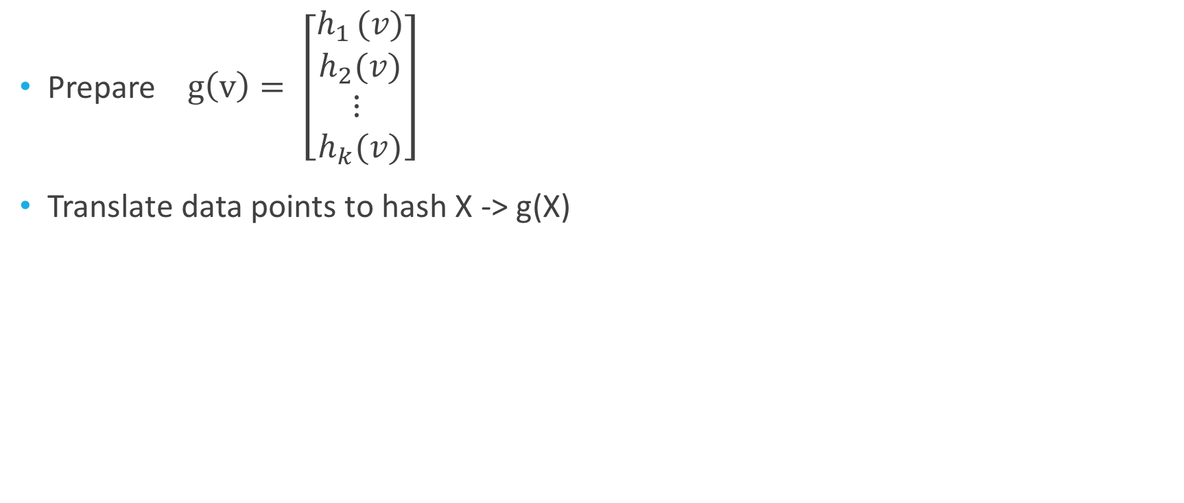
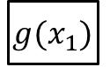
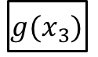
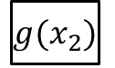
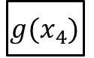
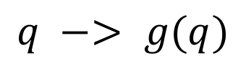
Locality Sensitive Hash
Prepare $g\left(v\right)= \left[\begin{aligned}h_{1 }(v) \\ h_{2}(v) \\ ⋮ \\ h_{k}(v)\end{aligned}\right]$
Translate data points to hash X -> g(X)
${g(x}_{1})$
${g(x}_{2})$
${g(x}_{3})$
$$q −> g(q)$$
${g(x}_{4})$
Search only in this backet
Hash table

Slide 22
Locality Sensitive Hash
Pros
High-speed
Able to determine approximation or performance theoretically
Cons
Probabilistic search -> low accuracy

Slide 23
Approximate Nearest Neighbor Search
Tree-based
Hash-based
Quantization
kd-tree
Approximate kd-tree
Randomized kd-tree
Hierarchial k-means
FLANN (RKD & HKM)
Locality sensitive hash (LSH)
Spectral Hashing (SH)
LVQ
Product Quantization (PQ)
IDFADC
LOPQ

Slide 24
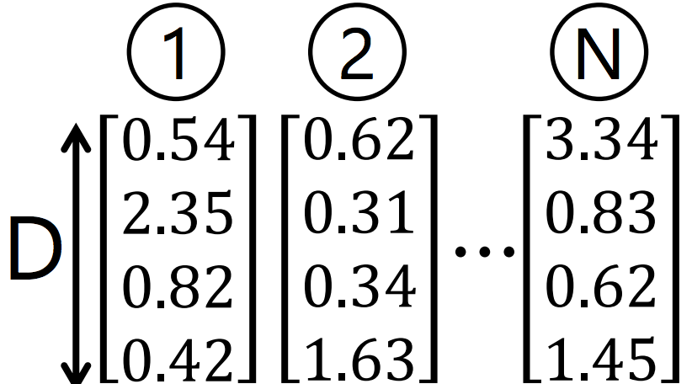
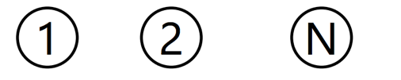
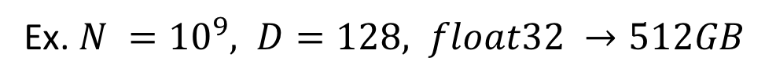
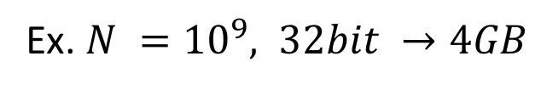
Quantization
ID: 8
ID: 123
ID: 32
Ex. $N ={10}^{9}, D=128, float32 →512GB$
Ex. $N ={10}^{9}, 32bit →4GB$

Slide 25
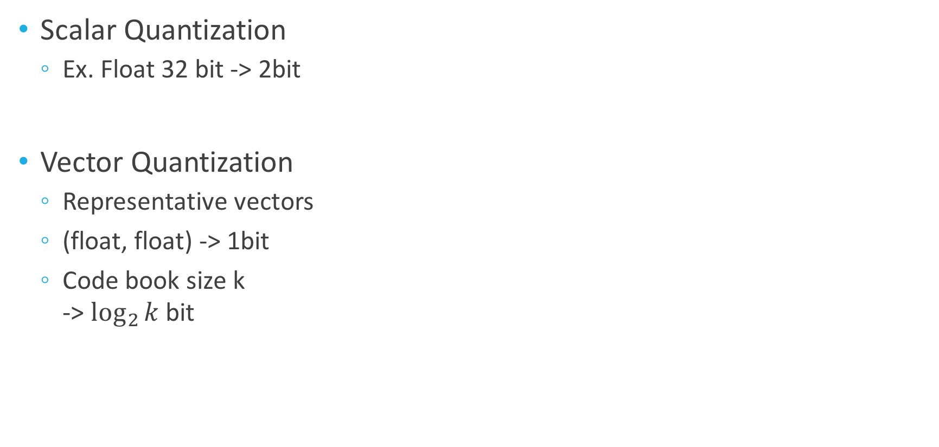
Quantization
Scalar Quantization
Ex. Float 32 bit -> 2bit
Vector Quantization
Representative vectors
(float, float) -> 1bit
Code book size k -> $\log_{2}{k}$ bit
K-means

Slide 26
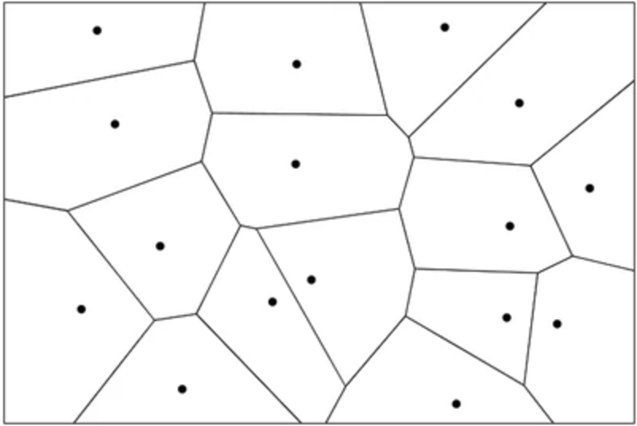
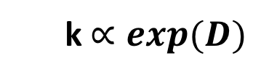
Voronoi diagram
k$∝exp⁡(D)$
Cannot apply to high dimension

Slide 27
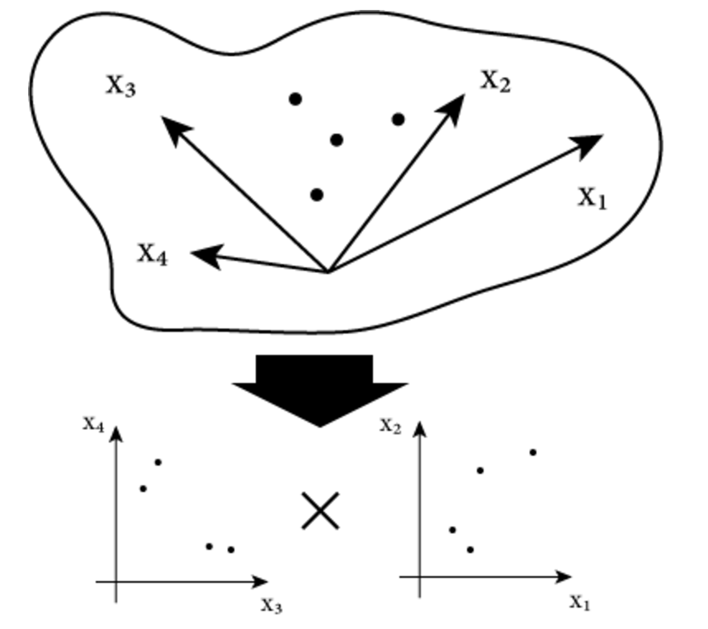
Product Quantization
Divide into sub-vector
Product (not tensor-product)

Slide 28
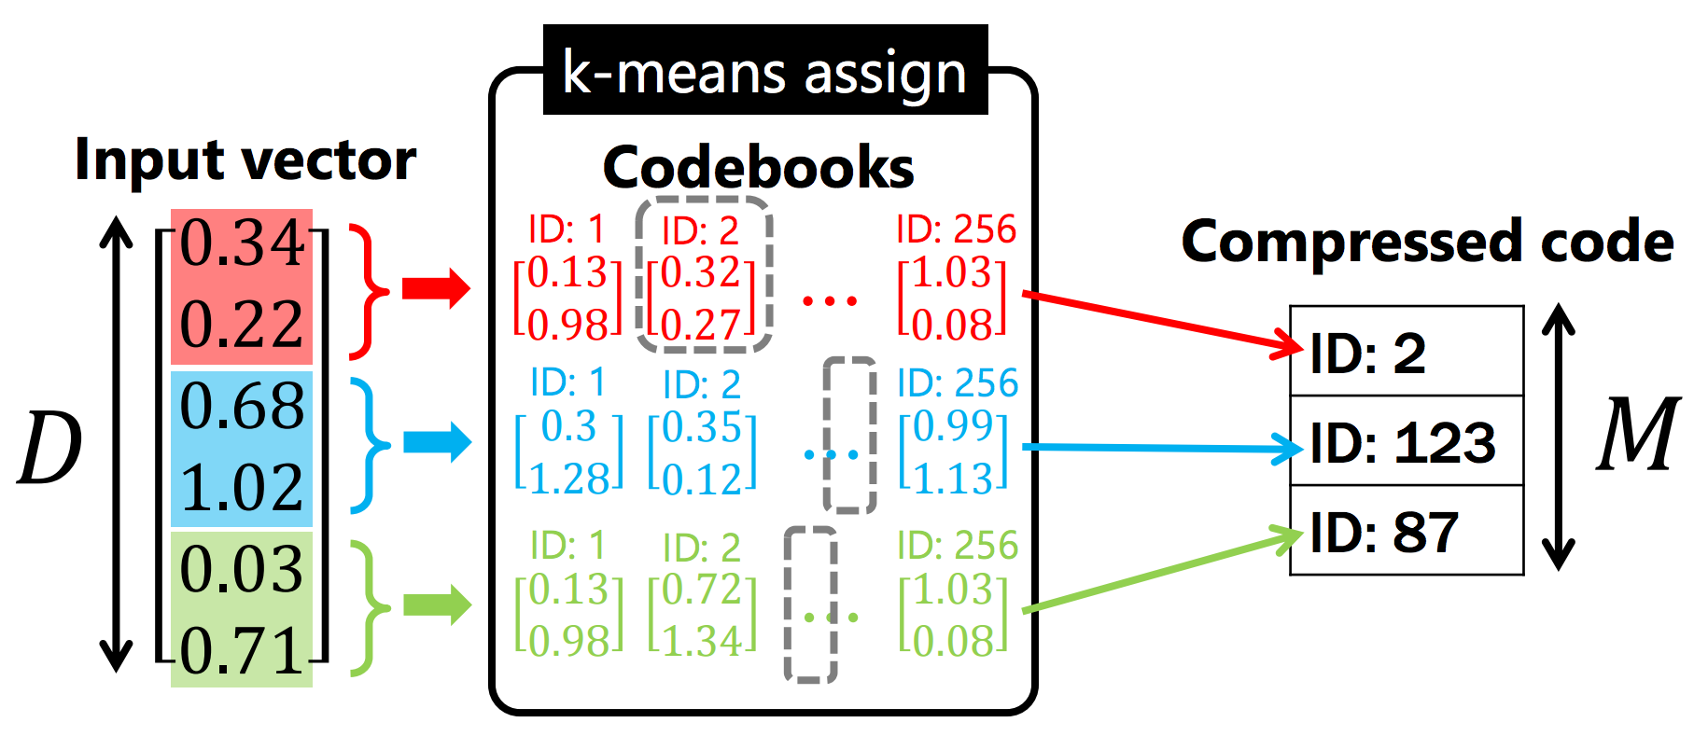
Product Quantization
Divide into sub-vector and k-means in each sub-vectors
http://yusukematsui.me/project/survey_pq/doc/ann_lecture_20161202.pdf

Slide 29
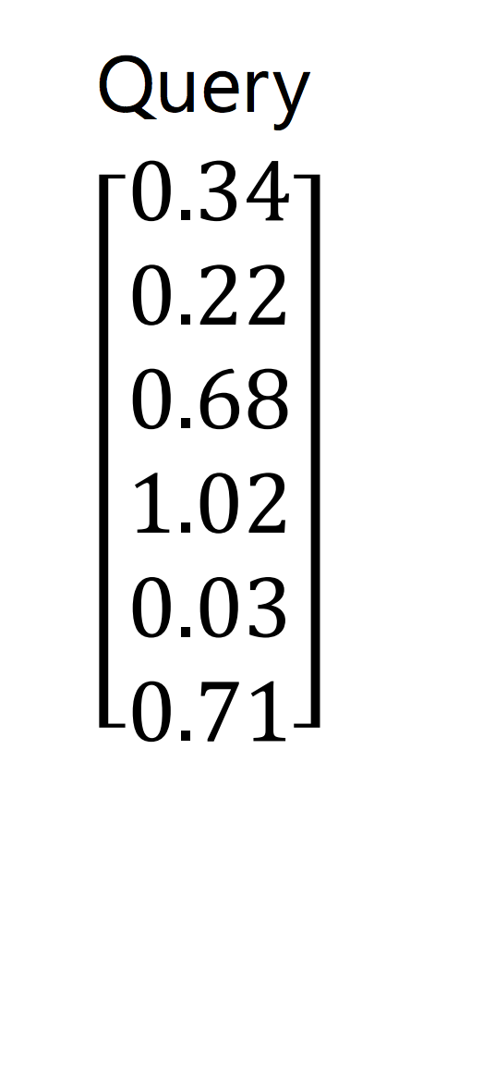

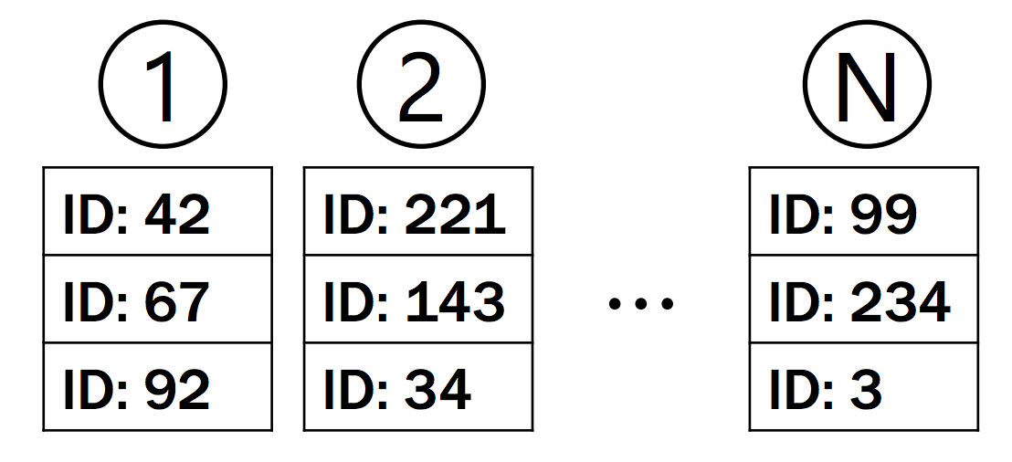
Product Quantization
Linear search!!
Compressed code

Slide 30
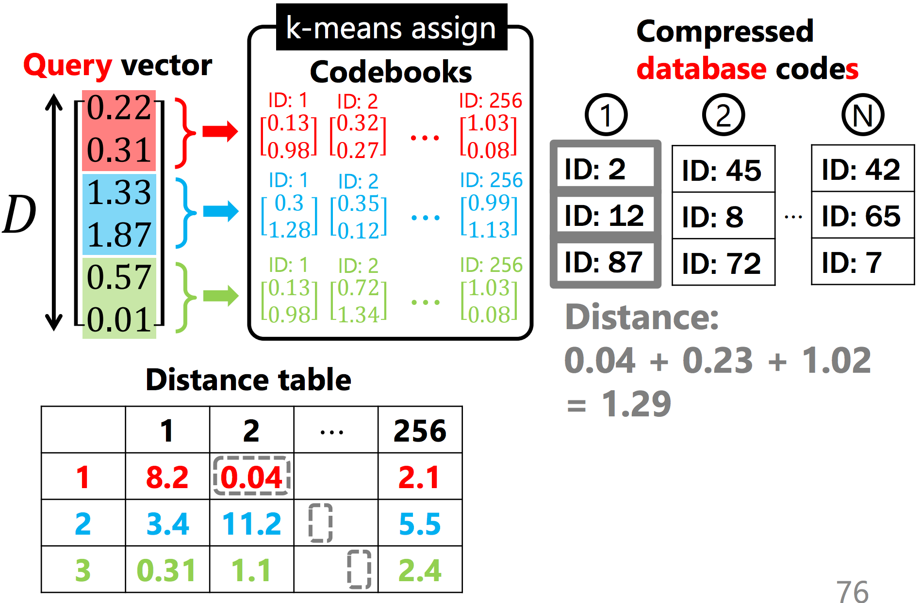

Product Quantization
Table lookup

Slide 31
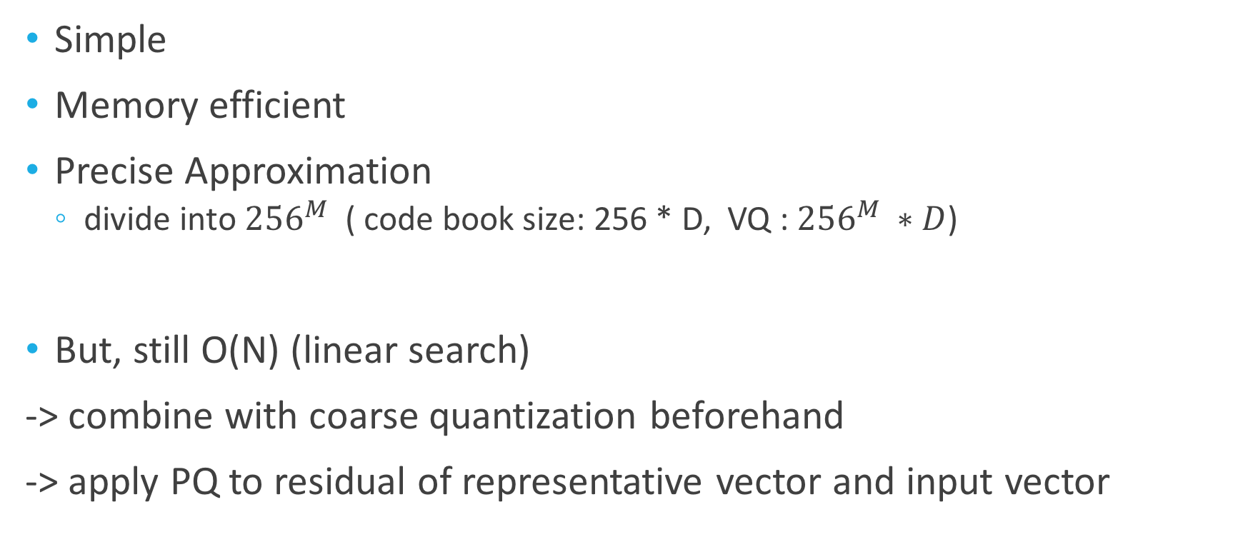
Product Quantization
Simple
Memory efficient
Precise Approximation
divide into ${256}^{M}$ ( code book size: 256 * D, VQ : ${256}^{M} ∗D$)
But, still O(N) (linear search)
-> combine with coarse quantization beforehand
-> apply PQ to residual of representative vector and input vector

Slide 32
Approximate Nearest Neighbor Search
Tree-based
Hash-based
Quantization
kd-tree
Approximate kd-tree
Randomized kd-tree
Hierarchial k-means
FLANN (RKD & HKM)
Locality sensitive hash (LSH)
Spectral Hashing (SH)
LVQ
Product Quantization (PQ)
IDFADC
LOPQ

Slide 33
Reference

